Slide 1
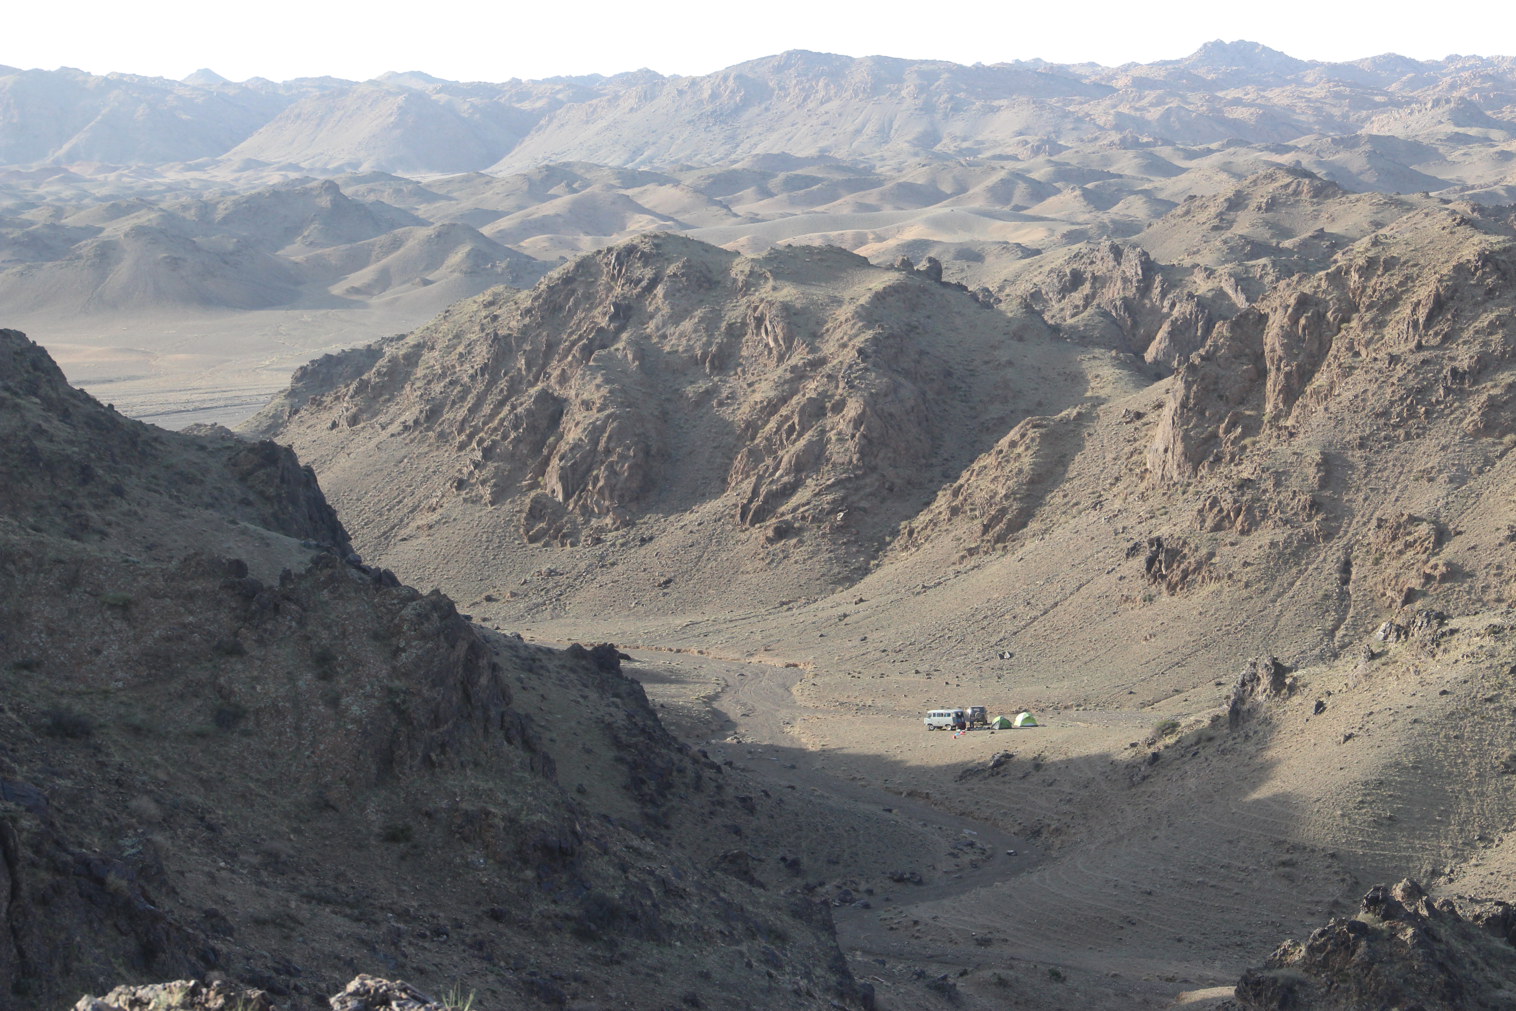
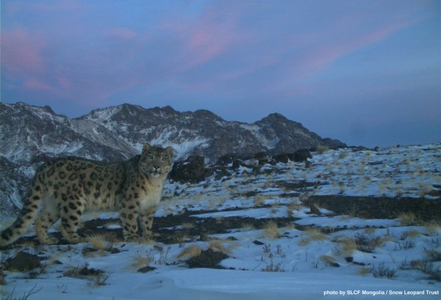

Double Observer training
Justine Alexander PhD
justine@snowleopard.org
Regional Ecologist Snow Leopard Trust
Notes:
Good morning everybody. I am very pleased to introduce a discussion on snow leopards and present to you some findings from a long-term study conducted in the South Gobi, spearheaded by the SLCF.
We will look at what we have learned from this multi-pronged study in the Gobi- a study that has over 8 years of camera trap data and were we have collared over 20 snow leopard individuals.
But first, lets start with the basics.

Slide 2
Double Observer Method
Double Observer Workshop
Ulaanbaatar, Mongolia
October 31st, 2017

Slide 3
Double observer surveys
The double-observer data can be regarded as two-sample mark–recapture.
Was originally developed to estimate the detection probabilities of aerial surveys of various taxonomic groups (Caughley 1974; Cook and Jaconson 1979; Graham and Bell 1989).
Forsyth and Hickling (1997) made an important contribution by applying the double-observer approach for estimating the abundance of Himalayan tahr (Hemitragus jemlahicus) in New Zealand.

Slide 4
Double observer survey for estimating mountain ungulate abundance
Most mountain ungulates cannot be individually identified
Thus, classical capture-recapture methods cannot be used
But, argali and ibex groups can be identified
Group size, age-sex classification, location of sighting provide cues for identification

Slide 5
Double observer survey- key assumptions
1. Groups can be individually identified
2. Population to be surveyed must be closed
3. Both surveys are simple random samples of the entire population (independent)

Slide 6
Assumption I: Individually identified
Groups can be individually identified
Group size
Age-sex classification
Location
Time of day
Post survey discussion between the two observers

Slide 7
Assumption II: closed survey
Population to be surveyed must be closed
Likely violations:
1. Groups re-assembling between the two surveys
2. Holes within study area
3. Porous study area borders
Past suggestions:
1. Simultaneous surveys provided surveyors don't cue each other

Slide 8
Assumption II- (Solutions)
Thumb rule: do entire survey FAST
SPEED= function of area
Ideally 7-10 days maximum
Do not want too long as weather changes and ungulates move
What if bad weather?
Is assumption that individuals moved violated?
Redo everything from first day?
Use the local knowledge / topography

Slide 9
Assumption III- I: random sample
Both observer surveys are simple random samples of the entire population
Can simultaneous surveying violate it?
P(group being detected by any observer) is dependent on:
1. Group size
2. Activity of the group
3. Distance from the observer

Slide 10
Assumption III- II: random sample
What happens when both observers survey together?
Groups size, activity and distance to both observers is constant
Thus,
P(group being detected by 1) ~ P(group detected by 2)
Leading to similar captures by both observers thus underestimating the population

Slide 11
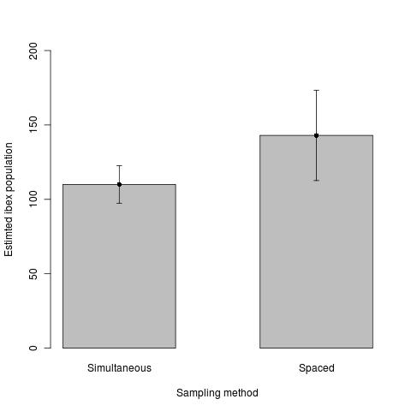
Field data

Slide 12
Assumption III- III (Solutions)
Time lag between the two surveys
Don't let the group size change
But allow the activity and distance to observer change
Observers walking the path in opposite directions
Allowing the observers to choose their own path
Both observers on opposite slopes or ridge of a valley

Slide 13
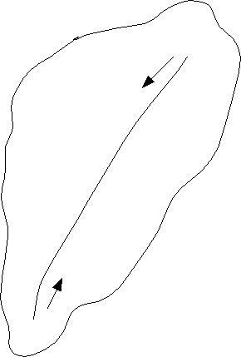
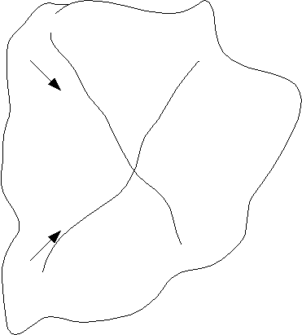
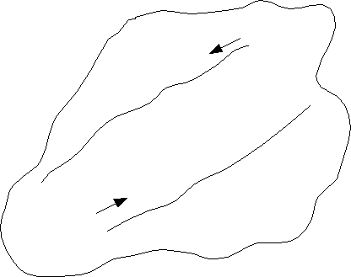
Survey Design
Design B
Design C
Design A

Slide 14
Double Observer Survey in Tost
Notes:
Steppe-desert with ‘isolated’ mountain massifs - the altitude ranges between 1600 m and 2400 m above mean sea level and although not very high, the mountain slopes are characterized by steep cliffs and crevices
Water is a limiting resource during summer as most waterholes dry up leaving only a few perennial springs to sustain wildlife
Legally, the entire study area now lies within the 7,000 km2 Tost Local Protected Area that was declared in 2011
Tost, Tosonbumba Mountain are not only important for snow leopard and biodiversity conservation, but are also home to 233 herder families with a total livestock holding of approximately 40,000 animals, comprised of goats, sheep, camels and horses.
The Snow Leopard Conservation Fund (SLCF) and Snow Leopard Trust (SLT) have been working since 2000 in the area- several community based conservation programs are active here, involving about 50-60 families. The programs focus on providing sustainable cash income for herder households who live in snow leopard habitat and in return herder groups and communities commit not to killing snow leopard and their prey in the area.

Slide 15
Field methods
Study area was further divided into smaller units of 20-40 km²
Two observers conducted independent counts within each sub-unit
Second surveyor would start half an hour after the first
Recorded group size, age-sex classification, location, time

Slide 16
Field methods

Slide 17
Limitation
Assumption of complete coverage of the area; no sampling
Large variance associated with variance in group size

Slide 18
Double Observer vs Distance Sampling
Double Observer surveys allows independent detection probabilities
The area is surveyed by 2 sets of eyes!
This increases the detection probability and Increases the Precision
Can obtain extra level of information
Ex. If the detection prob is low for 2nd Observer. Sign of evasive behaviour
Look at Sex Ratio over years

Slide 19
Sample Size
Distance Sampling
Sample sizes (number of objects observed) are sufficient to provide robust estimates of the detection function and its variance.
60~80 observations (at least 40)
At least 15~20 transects for reliable estimation of variance

Slide 20
Double Observer vs Distance Sampling Example from China
Density:
14.48
95% CI:
10.37-18.59
Abundance:
2085
95% CI:
1493-2677
Detection probability:
0.576, 0.528
Density:
15.20
95% CI:
8.38-27.58
Abundance:
2189
95% CI:
1207-3972
Detection probability:
0.49

Slide 21
Double Observer
The double- observer survey is a simple, cheap and relatively fast method
Also being statistically robust and sufficiently precise for ecological studies.

Slide 22
Future avenues
Analysis using likelihoods
Incorporating group size related variance in estimating detection probability
Reduce variance around estimate
Sampling based approach

